Slide 1
Private and Trusted Interactions*
Bharat Bhargava, Leszek Lilien, and Dongyan Xu
{bb, llilien, dxu}@cs.purdue.edu)
Department of Computer Sciences, CERIAS† and CWSA‡
Purdue University
in collaboration with Ph.D. students and postdocs in the Raid Lab
Computer Sciences Building, Room CS 145, phone: 765-494-6702
www.cs.purdue.edu/homes/bb
* Supported in part by NSF grants IIS-0209059, IIS-0242840, ANI-0219110, and Cisco URP grant. More grants are welcomed!
† Center for Education and Research in Information Assurance and Security (Executive Director: Eugene Spafford)
‡ Center for Wireless Systems and Applications (Director: Catherine P. Rosenberg)

Slide 2
Motivation
Sensitivity of personal data [Ackerman et al. ‘99]
  82% willing to reveal their favorite TV show
  Only 1% willing to reveal their SSN
Business losses due to privacy violations
  Online consumers worry about revealing personal data
  This fear held back $15 billion in online revenue in 2001
Federal Privacy Acts to protect privacy
  E.g., Privacy Act of 1974 for federal agencies
    Still many examples of privacy violations even by federal agencies
      JetBlue Airways revealed travellers’ data to federal gov’t
  E.g., Health Insurance Portability and Accountability Act of 1996 (HIPAA)

Slide 3
Privacy and Trust
Privacy Problem
  Consider computer-based interactions
    From a simple transaction to a complex collaboration
  Interactions involve dissemination of private data
    It is voluntary, “pseudo-voluntary,” or required by law
  Threats of privacy violations result in lower trust
  Lower trust leads to isolation and lack of collaboration
Trust must be established
  Data – provide quality an integrity
  End-to-end communication – sender authentication, message integrity
  Network routing algorithms – deal with malicious peers, intruders, security attacks

Slide 4
Fundamental Contributions
Provide measures of privacy and trust
Empower users (peers, nodes) to control privacy in ad hoc environments
  Privacy of user identification
  Privacy of user movement
Provide privacy in data dissemination
  Collaboration
  Data warehousing
  Location-based services
Tradeoff between privacy and trust
  Minimal privacy disclosures
    Disclose private data absolutely necessary to gain a level of trust required by the partner system

Slide 5
Proposals and Publications
Submitted NSF proposals
  “Private and Trusted Interactions,” by B. Bhargava (PI) and L. Lilien (co-PI), March 2004.
  “Quality Healthcare Through Pervasive Data Access,” by D. Xu (PI), B. Bhargava, C.-K.K. Chang, N. Li, C. Nita-Rotaru (co-PIs), March 2004.
Selected publications
  “On Security Study of Two Distance Vector Routing Protocols for Mobile Ad Hoc Networks,” by W. Wang, Y. Lu and B. Bhargava, Proc. of IEEE Intl. Conf. on Pervasive Computing and Communications (PerCom 2003), Dallas-Fort Worth, TX, March 2003. http://www.cs.purdue.edu/homes/wangwc/PerCom03wangwc.pdf
  “Fraud Formalization and Detection,” by B. Bhargava, Y. Zhong and Y. Lu, Proc. of 5th Intl. Conf. on Data Warehousing and Knowledge Discovery (DaWaK 2003), Prague, Czech Republic, September 2003. http://www.cs.purdue.edu/homes/zhong/papers/fraud.pdf
  “Trust, Privacy, and Security. Summary of a Workshop Breakout Session at the National Science Foundation Information and Data Management (IDM) Workshop held in Seattle, Washington, September 14 - 16, 2003” by B. Bhargava, C. Farkas, L. Lilien and F. Makedon, CERIAS Tech Report 2003-34, CERIAS, Purdue University, November 2003.
  http://www2.cs.washington.edu/nsf2003 or
  https://www.cerias.purdue.edu/tools_and_resources/bibtex_archive/archive/2003-34.pdf
  “e-Notebook Middleware for Accountability and Reputation Based Trust in Distributed Data Sharing Communities,” by P. Ruth, D. Xu, B. Bhargava and F. Regnier, Proc. of the Second International Conference on Trust Management (iTrust 2004), Oxford, UK, March 2004. http://www.cs.purdue.edu/homes/dxu/pubs/iTrust04.pdf
  “Position-Based Receiver-Contention Private Communication in Wireless Ad Hoc Networks,” by X. Wu and B. Bhargava, submitted to the Tenth Annual Intl. Conf. on Mobile Computing and Networking (MobiCom’04), Philadelphia, PA, September - October 2004.
  http://www.cs.purdue.edu/homes/wu/HTML/research.html/paper_purdue/mobi04.pdf

Slide 6
Outline
Assuring privacy in data dissemination
Privacy-trust tradeoff
Privacy metrics
Example applications to networks and e-commerce
  Privacy in location-based routing and services in wireless networks
  Privacy in e-supply chain management systems
Prototype for experimental studies

Slide 7







1. Privacy in Data Dissemination
“Owner”
(Private Data Owner)
Guardian 1
Original Guardian
“Data”
(Private Data)
Guardian 5
Third-level
Guardian 2
Second Level
Guardian 4
Guardian 3
Guardian 6
“Guardian:”
Entity entrusted by private data owners with collection, storage, or transfer of their data
  owner can be a guardian for its own private data
  owner can be an institution or a system
Guardians allowed or required by law to share private data
  With owner’s explicit consent
  Without the consent as required by law
    research, court order, etc.

Slide 8
Problem of Privacy Preservation
Guardian passes private data to another guardian in a data dissemination chain
  Chain within a graph (possibly cyclic)
Owner privacy preferences not transmitted due to neglect or failure
  Risk grows with chain length and milieu fallibility and hostility
If preferences lost, receiving guardian unable to honor them

Slide 9
Challenges
Ensuring that owner’s metadata are never decoupled from his data
  Metadata include owner’s privacy preferences
Efficient protection in a hostile milieu
  Threats - examples
    Uncontrolled data dissemination
    Intentional or accidental data corruption, substitution, or disclosure
  Detection of data or metadata loss
  Efficient data and metadata recovery
    Recovery by retransmission from the original guardian is most trustworthy

Slide 10
Related Work
Self-descriptiveness
  Many papers use the idea of self-descriptiveness in diverse contexts (meta data model, KIF, context-aware mobile infrastructure, flexible data types)
Use of self-descriptiveness for data privacy
  The idea briefly mentioned in [Rezgui, Bouguettaya, and Eltoweissy, 2003]
Securing mobile self-descriptive objects
  Esp. securing them via apoptosis, that is clean self-destruction [Tschudin, 1999]
Specification of privacy preferences and policies
  Platform for Privacy Preferences [Cranor, 2003]
  AT&T Privacy Bird [AT&T, 2004]

Slide 11
Proposed Approach
Design self-descriptive private objects
Construct a mechanism for apoptosis of private objects
  apoptosis = clean self-destruction
Develop proximity-based evaporation of private objects

Slide 12
A. Self-descriptive Private Objects
Comprehensive metadata include:
  owner’s privacy preferences
  guardian privacy policies
  metadata access conditions
  enforcement specifications
  data provenance
  context-dependent and
  other components
  How to read and write private data
  For the original and/or subsequent data guardians
  How to verify and modify metadata
  How to enforce preferences and policies
  Who created, read, modified, or destroyed any portion of data
  Application-dependent elements
  Customer trust levels for different contexts
  Other metadata elements

Slide 13
Notification in Self-descriptive Objects
Self-descriptive objects simplify notifying owners or requesting their permissions
  Contact information available in the data provenance component
Notifications and requests sent to owners immediately, periodically, or on demand
  Via pagers, SMSs, email, mail, etc.

Slide 14
Optimization of Object Transmission
Transmitting complete objects between guardians is inefficient
  They describe all foreseeable aspects of data privacy
    For any application and environment
Solution: prune transmitted metadata
  Use application and environment semantics along the data dissemination chain

Slide 15
B. Apoptosis of Private Objects
Assuring privacy in data dissemination
  In benevolent settings:
  use atomic self-descriptive object with retransmission recovery
  In malevolent settings:
  when attacked object threatened with disclosure, use apoptosis (clean self-destruction)
Implementation
  Detectors, triggers, code
  False positive
    Dealt with by retransmission recovery
    Limit repetitions to prevent denial-of-service attacks
  False negatives

Slide 16
C. Proximity-based Evaporation of Private Data
Perfect data dissemination not always desirable
  Example: Confidential business data shared within
  an office but not outside
Idea: Private data evaporate in proportion to
their “distance” from their owner
  “Closer” guardians trusted more than “distant” ones
  Illegitimate disclosures more probable at less trusted “distant” guardians
  Different distance metrics
    Context-dependent

Slide 17
Examples of Metrics
Examples of one-dimensional distance metrics
  Distance ~ business type
  Distance ~ distrust level: more trusted entities are “closer”
Multi-dimensional distance metrics
  Security/reliability as one of dimensions
Insurance Company C
Bank I -Original Guardian
Used Car Dealer 1
    If a bank is the original guardian, then:
    -- any other bank is “closer” than any insurance company
    -- any insurance company is “closer” than any used car dealer
2
5
Used Car Dealer 3
2
5
Insurance Company A
1
1
5
2
Used Car Dealer 2
Bank II
Bank III
Insurance Company B

Slide 18




Evaporation Implemented as
Controlled Data Distortion
Distorted data reveal less, protecting privacy
Examples:
  accurate more and more distorted
  250 N. Salisbury Street
  West Lafayette, IN
  250 N. Salisbury Street
  West Lafayette, IN
  [home address]
  765-123-4567
  [home phone]
  Salisbury Street
  West Lafayette, IN
  250 N. University Street
  West Lafayette, IN
  [office address]
  765-987-6543
  [office phone]
  somewhere in
  West Lafayette, IN
  P.O. Box 1234
  West Lafayette, IN
  [P.O. box]
  765-987-4321
  [office fax]

Slide 19
Evaporation as
Apoptosis Generalization
Context-dependent apoptosis for implementing evaporation
  Apoptosis detectors, triggers, and code enable context exploitation
Conventional apoptosis as a simple case of data evaporation
  Evaporation follows a step function
    Data self-destructs when proximity metric exceeds predefined threshold value

Slide 20
Application of Evaporation for DRM
Evaporation used for digital rights management
  Objects self-destruct when copied onto ”foreign” media or storage device

Slide 21
Outline
Assuring privacy in data dissemination
Privacy-trust tradeoff
Privacy metrics
Example applications to networks and e-commerce
  Privacy in location-based routing and services in wireless networks
  Privacy in e-supply chain management systems
Prototype for experimental studies

Slide 22
2. Privacy-trust Tradeoff
Problem
  To build trust in open environments, users provide digital credentials that contain private information
  How to gain a certain level of trust with the least loss of privacy?
Challenges
  Privacy and trust are fuzzy and multi-faceted concepts
  The amount of privacy lost by disclosing a piece of information is affected by:
    Who will get this information
    Possible uses of this information
    Information disclosed in the past

Slide 23
Related Work
Automated trust negotiation (ATN) [Yu, Winslett, and Seamons, 2003]
  Tradeoff between the length of the negotiation, the amount of information disclosed, and the computation effort
Trust-based decision making [Wegella et al. 2003]
  Trust lifecycle management, with considerations of both trust and risk assessments
Trading privacy for trust [Seigneur and Jensen, 2004]
  Privacy as the linkability of pieces of evidence to a pseudonym; measured by using nymity [Goldberg, thesis, 2000]

Slide 24
Proposed Approach
Formulate the privacy-trust tradeoff problem
Estimate privacy loss due to disclosing a set of credentials
Estimate trust gain due to disclosing a set of credentials
Develop algorithms that minimize privacy loss for required trust gain

Slide 25
A. Formulate Tradeoff Problem
Set of private attributes that user wants to conceal
Set of credentials
  Subset of revealed credentials R
  Subset of unrevealed credentials U
Choose a subset of credentials NC from U such that:
  NC satisfies the requirements for trust building
  PrivacyLoss(NC+R) – PrivacyLoss(R) is minimized

Slide 26
Formulate Tradeoff Problem - cont.1
If multiple private attributes are considered:
  Weight vector {w₁, w₂, …, w_{m}} for private attributes
  Privacy loss can be evaluated using:
    The weighted sum of privacy loss for all attributes
    The privacy loss for the attribute with the highest weight

Slide 27
B. Estimate Privacy Loss
Query-independent privacy loss
  Provided credentials reveal the value of a private attribute
  User determines her private attributes
Query-dependent privacy loss
  Provided credentials help in answering a specific query
  User determines a set of potential queries that she is reluctant to answer

Slide 28
Privacy Loss Example
Private attribute
  age
Potential queries:
  (Q1) Is Alice an elementary school student?
  (Q2) Is Alice older than 50 to join a silver insurance plan?
Credentials
  (C1) Driver license
  (C2) Purdue undergraduate student ID

Slide 29
Example – cont.
No credentials
Disclose C1 (driver license)
Disclose C2 (undergrad ID)
C2 implies undergrad
and suggests
age ≤ 25 (high probability)
Query 1 (elem. school): no
Query 2 (silver plan):
no (high probability)
C1 implies age ≥ 16
Query 1 (elem. school): no
Query 2 (silver plan): not sure
Disclose C2
Disclose C1
C1 and C2 suggest
16≤ age ≤ 25 (high probability)
Query 1 (elem. school): no
Query 2 (silver plan):
no (high probability)

Slide 30
Example - Observations
Disclose license (C1) and then unergrad ID (C2)
  Privacy loss by disclosing license
    low query-independent loss (wide range for age)
    100% loss for Query 1 (elem. school student)
    low loss for Query 2 (silver plan)
  Privacy loss by disclosing ID after license
    high query-independent loss (narrow range for age)
    zero loss for Query 1 (because privacy was lost by disclosing license)
    high loss for Query 2 (“not sure” → “no - high probability”
Disclose undergrad ID (C2) and then license (C1)
  Privacy loss by disclosing ID
    low query-independent loss (wide range for age)
    100% loss for Query 1 (elem. school student)
    high loss for Query 2 (silver plan)
  Privacy loss by disclosing license after ID
    high query-independent loss (narrow range of age)
    zero loss for Query 1 (because privacy was lost by disclosing ID)
    zero loss for Query 2

Slide 31
Example - Summary
High query-independent loss does not necessarily imply high query-dependent loss
  e.g., disclosing ID after license causes
    high query-independent loss
    zero loss for Query 1
Privacy loss is affected by the order of disclosure
  e.g., disclosing ID after license causes different privacy loss than disclosing license after ID

Slide 32
Privacy Loss Estimation Methods
Probability method
  Query-independent privacy loss
    Privacy loss is measured as the difference between entropy values
  Query-dependent privacy loss
    Privacy loss for a query is measured as difference between entropy values
    Total privacy loss is determined by the weighted average
  Conditional probability is needed for entropy evaluation
    Bayes networks and kernel density estimation will be adopted
Lattice method
  Estimate query-independent loss
  Each credential is associated with a tag indicating its privacy level with respect to an attribute a_{j}
  Tag set is organized as a lattice
  Privacy loss measured as the least upper bound of the privacy levels for candidate credentials

Slide 33
C. Estimate Trust Gain
Increasing trust level
  Adopt research on trust establishment and management
Benefit function B(trust_level)
  Provided by service provider or derived from user’s utility function
Trust gain
  B(trust_level_{new}) - B(tust_level_{prev})

Slide 34
D. Minimize Privacy Loss for Required Trust Gain
Can measure privacy loss (B) and can estimate trust gain (C)
Develop algorithms that minimize privacy loss for required trust gain
  User releases more private information
  System’s trust in user increases
  How much to disclose to achieve a target trust level?

Slide 35
Outline
Assuring privacy in data dissemination
Privacy-trust tradeoff
Privacy metrics
Example applications to networks and e-commerce
  Privacy in location-based routing and services in wireless networks
  Privacy in e-supply chain management systems
Prototype for experimental studies

Slide 36
3. Privacy Metrics
Problem
  How to determine that certain degree of data privacy is provided?
Challenges
  Different privacy-preserving techniques or systems claim different degrees of data privacy
  Metrics are usually ad hoc and customized
    Customized for a user model
    Customized for a specific technique/system
  Need to develop uniform privacy metrics
    To confidently compare different techniques/systems

Slide 37
Requirements for Privacy Metrics
Privacy metrics should account for:
  Dynamics of legitimate users
    How users interact with the system?
    E.g., repeated patterns of accessing the same data can leak information to a violator
  Dynamics of violators
    How much information a violator gains by watching the system for a period of time?
  Associated costs
    Storage, injected traffic, consumed CPU cycles, delay

Slide 38
Related Work
Anonymity set without accounting for probability distribution [Reiter and Rubin, 1999]
An entropy metric to quantify privacy level, assuming static attacker model [Diaz et al., 2002]
Differential entropy to measure how well an attacker estimates an attribute value [Agrawal and Aggarwal 2001]

Slide 39
Proposed Approach
Anonymity set size metrics
Entropy-based metrics

Slide 40
A. Anonymity Set Size Metrics
The larger set of indistinguishable entities, the lower probability of identifying any one of them
  Can use to ”anonymize” a selected private attribute value within the domain of its all possible values
“Hiding in a crowd”
“Less” anonymous (1/4)
“More” anonymous (1/n)

Slide 41
Anonymity Set
Anonymity set A
A = {(s₁, p₁), (s₂, p₂), …, (s_{n}, p_{n})}
  s_{i}: subject i who might access private data
  or: i-th possible value for a private data attribute
  p_{i}: probability that s_{i} accessed private data
  or: probability that the attribute assumes the i-th possible value

Slide 42
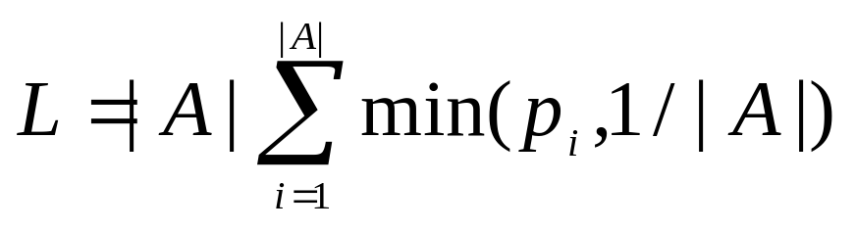
Effective Anonymity Set Size
Effective anonymity set size is
  Maximum value of L is |A| iff all p_{i’}’s are equal to 1/|A|
  L below maximum when distribution is skewed
    skewed when p_{i’}’s have different values
Deficiency:
L does not consider violator’s learning behavior

Slide 43
B. Entropy-based Metrics
Entropy measures the randomness, or uncertainty, in private data
When a violator gains more information, entropy decreases
Metric: Compare the current entropy value with its maximum value
  The difference shows how much information has been leaked

Slide 44
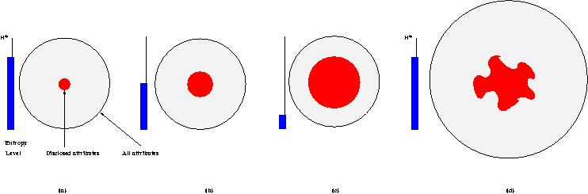
Dynamics of Entropy
Decrease of system entropy with attribute disclosures (capturing dynamics)
  When entropy reaches a threshold (b), data evaporation can be invoked to increase entropy by controlled data distortions
  When entropy drops to a very low level (c), apoptosis can be triggered to destroy private data
  Entropy increases (d) if the set of attributes grows or the disclosed attributes become less valuable – e.g., obsolete or more data now available
H*
Entropy
Level
Disclosed attributes
All
attributes
(a)
(b)
(c)
(d)

Slide 45
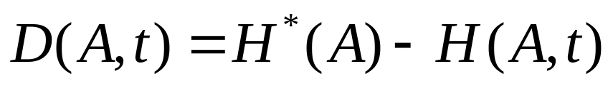
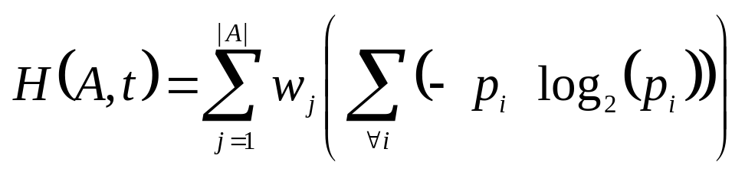
Quantifying Privacy Loss
Privacy loss D(A,t) at time t, when a subset of attribute values A might have been disclosed:
  H*(A) – the maximum entropy
    Computed when probability distribution of p_{i}’s is uniform
  H(A,t) is entropy at time t
  w_{j} – weights capturing relative privacy “value” of attributes

Slide 46
Using Entropy in Data Dissemination
Specify two thresholds for D
  For triggering evaporation
  For triggering apoptosis
When private data is exchanged
  Entropy is recomputed and compared to the thresholds
  Evaporation or apoptosis may be invoked to enforce privacy

Slide 47
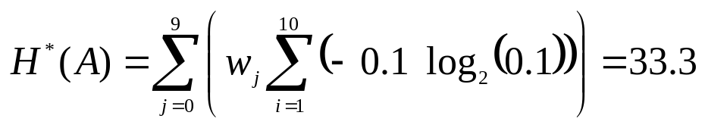
Entropy: Example
Consider a private phone number: (a₁a₂a₃) a₄a₅ a₆ – a₇a₈a₉ a₁₀
Each digit is stored as a value of a separate attribute
Assume:
  Range of values for each attribute is [0—9]
  All attributes are equally important, i.e., w_{j} = 1
The maximum entropy – when violator has no information about the value of each attribute:
  Violator assigns a uniform probability distribution to values of each attribute
    e.g., a₁= i with probability of 0.10 for each i in [0—9]

Slide 48
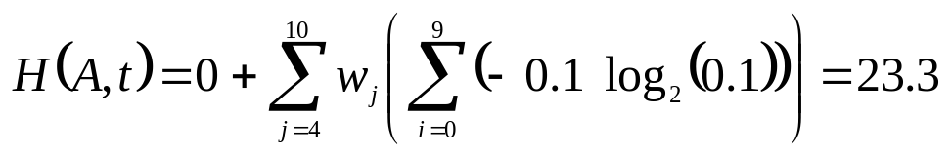

Entropy: Example – cont.
Suppose that after time t, violator can figure out the state of the phone number, which may allow him to learn the three leftmost digits
Entropy at time t is given by:
  Attributes a₁, a₂, a₃ contribute 0 to the entropy value because violator knows their correct values
Information loss at time t is:

Slide 49
Outline
Assuring privacy in data dissemination
Privacy-trust tradeoff
Privacy metrics
Example applications to networks and e-commerce
  Privacy in location-based routing and services in wireless networks
  Privacy in e-supply chain management systems
Prototype for experimental studies

Slide 50
4a. Application: Privacy in LBRS for Wireless Networks
LBRS = location-based routing and services
Problem
  Users need and want LBRS
  LBRS users do not want their stationary or mobile locations widely known
  Users do not want their movement patterns widely known
Challenge
  Design mechanisms that preserve location and movement privacy while using LBRS

Slide 51
Related Work
Range-free localization scheme using Point-in-Triangulation [He et al., MobiCom’03]
Geographic routing without exact location [Rao et al., MobiCom’03]
Localization from connectivity [Shang et al., MobiHoc 03]
Anonymity during routing in ad hoc networks [Kong et al., MobiHoc’03]
Location uncertainty in mobile networks [Wolfson et al., Distributed and Parallel Databases’99]
Querying imprecise data in mobile environments [Cheng et al., TKDE’04]

Slide 52
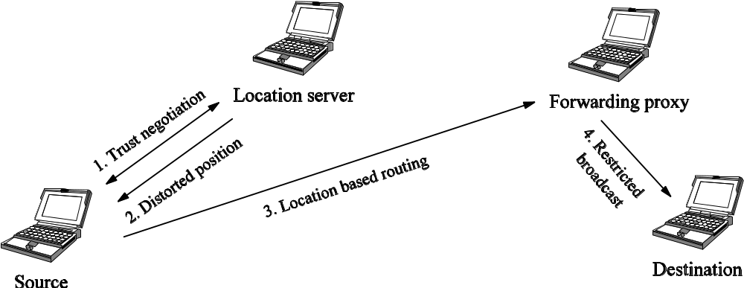
Proposed Approach: Basic Idea
Location server distorts actual positions
  Provide approximate position (stale or grid)
  Accuracy of provided information is a function of the trust level that location server assigns to the requesting node
Send to forwarding proxy (FP) at approximate position
Then apply restricted broadcast by FP to transmit the packet to its final destination

Slide 53
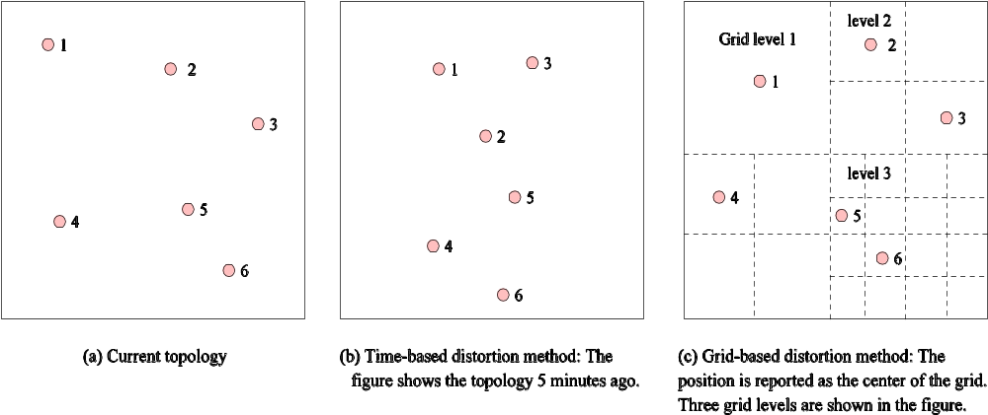
Trust and Data Distortion
Trust negotiation between source and location server
  Automatic decision making to achieve tradeoff between privacy loss and network performance
Dynamic mappings between trust level and distortion level
  Hiding destination in an anonymity set to avoid being traced

Slide 54
Trust Degradation and Recovery
Identification and isolation of privacy violators
  Dynamic trust updated according to interaction histories and peer recommendations
Fast degradation of trust and its slow recovery
  This defends against smart violators

Slide 55
Contributions
More secure and scalable routing protocol
Advances in QoS control for wireless networks
Improved mechanisms for privacy measurement and information distortion
Advances in privacy violation detection and violator identification

Slide 56
Outline
Assuring privacy in data dissemination
Privacy-trust tradeoff
Privacy metrics
Example applications to networks and e-commerce
  Privacy in location-based routing and services in wireless networks
  Privacy in e-supply chain management systems
Prototype for experimental studies

Slide 57
4b. Application: Privacy in e-Supply Chain Management Systems
Problem
  Inadequacies in privacy protection for e-supply chain management system (e-SCMS) hamper their development
Challenges
  Design privacy-related components for privacy-preserving e-SCMS
    When and with whom to share private data?
    How to control their disclosures?
    How to accommodate and enforce privacy policies and preferences?
    How to evaluate and compare alternative preferences and policies?

Slide 58
Related Work
Coexistence and compatibility of e-privacy and e-commerce [Frosch-Wilke, 2001; Sandberg, 2002]
  Context: electronic customer relationship management (e-CRM)
  e-CRM includes e-SCMS
Privacy as a major concern in online e-CRM systems for providing personalization and recommendation services [Ramakrishnan, 2001]
Privacy-preserving personalization techniques [Ishitani et al., 2003]
Privacy preserving collaborative filtering systems [Mender project, http://www.cs.berkeley.edu/~jfc/'mender/]
Privacy-preserving data mining systems [Privacy, Obligations, and Rights in Technologies of Information Assessment http://theory.stanford.edu/~rajeev/privacy.html]

Slide 59
Proposed Approach
Intelligent data sharing
  Implementation of privacy preferences and policies at data warehouses
  Evaluation of credentials and requester trustworthiness
  Evaluation of cost benefits of privacy loss vs. trust gain
Controlling misuse
  Automatic enforcement via private objects
  Distortion / summarization
  Apoptosis
  Evaporation

Slide 60
Proposed Approach – cont.
Enforcing and integrating privacy components
  Using privacy metrics for policy evaluation before its implementation
  Integration of privacy-preservation components with e-SCMS software
  Modeling and simulation of privacy-related components for e-SCMS
  Prototyping privacy-related components for e-SCMS
  Evaluating the effectiveness, efficiency and usability of the privacy mechanisms on PRETTY prototype
  Devising a privacy framework for e-SCMS applications

Slide 61
Outline
Assuring privacy in data dissemination
Privacy-trust tradeoff
Privacy metrics
Example applications to networks and e-commerce
  Privacy in location-based routing and services in wireless networks
  Privacy in e-supply chain management systems
Prototype for experimental studies

Slide 62
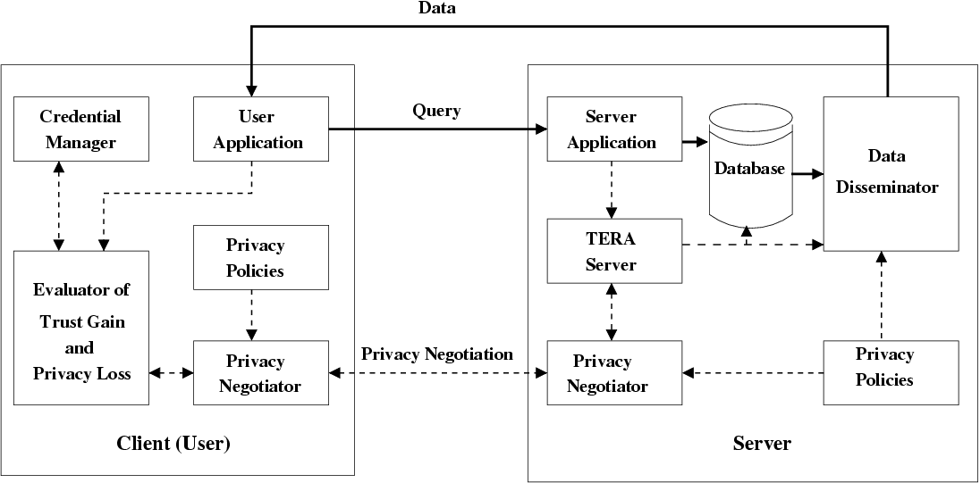
5. PRETTY Prototype for Experimental Studies
(4)
(1)
[2c2]
(2)
(3) User Role
[2a]
[2b] [2d]
[2c1]
(<nr>) – unconditional path
[<nr>]– conditional path
TERA = Trust-Enhanced Role Assignment

Slide 63
Information Flow for PRETTY
User application sends query to server application.
Server application sends user information to TERA server for trust evaluation and role assignment.
  If a higher trust level is required for query, TERA server sends the request for more user’s credentials to privacy negotiator.
  Based on server’s privacy policies and the credential requirements, privacy negotiator interacts with user’s privacy negotiator to build a higher level of trust.
  Trust gain and privacy loss evaluator selects credentials that will increase trust to the required level with the least privacy loss. Calculation considers credential requirements and credentials disclosed in previous interactions.
  According to privacy policies and calculated privacy loss, user’s privacy negotiator decides whether or not to supply credentials to the server.
Once trust level meets the minimum requirements, appropriate roles are assigned to user for execution of his query.
Based on query results, user’s trust level and privacy polices, data disseminator determines: (i) whether to distort data and if so to what degree, and (ii) what privacy enforcement metadata should be associated with it.

Slide 64
Example Experimental Studies
Private object implementation
  Validate and evaluate the cost, efficiency, and the impacts on the dissemination of objects
  Study the apoptosis and evaporation mechanisms for private objects
Tradeoff between privacy and trust
  Study the effectiveness and efficiency of the probability-based and lattice-based privacy loss evaluation methods
  Assess the usability of the evaluator of trust gain and privacy loss
Location-based routing and services
  Evaluate the dynamic mappings between trust levels and distortion levels

Slide 65
Private and Trusted Interactions - Summary
Assuring privacy in data dissemination
Privacy-trust tradeoff
Privacy metrics
Example applications to networks and e-commerce
  Privacy in location-based routing and services in wireless networks
  Privacy in e-supply chain management systems
Prototype for experimental studies

Slide 66
Bird’s Eye View of Research
Research integrates ideas from:
  Cooperative information systems
  Collaborations
  Privacy, trust, and information theory
General privacy solutions provided
Example applications studied:
  Location-based routing and services for wireless networks
  Electronic supply chain management systems
Applicability to:
  Ad hoc networks, peer-to-peer systems
  Diverse computer systems
  The Semantic Web

